Slide 1
Preprocessing
1
2
3
Red Light Camera Dataframe RL_df
Killed or Seriously Injured DF
KSI_df
Red Light Camera + KSI
Geomerge_df
Inspect the initial dataframe reviewing the shape and info
Dropped unnecessary columns
The geometry field was parsed so that Latitude & Longitude could be used to match records between the red light camera file and the killed seriously injured file. The geometry field contained geo-coordinates in a JSON string format. A two-step process was employed. The first step was to first extract the numeric string and then to split the numeric string into Latitude and Longitude and place these values in their own columns.
Inspect the initial dataframe reviewing the shape and info
The file contains duplicate accident records where each row represents a person involved in the accident. The dataframe contains person specific columns and accident specific columns. The next few actions involved cleaning the data so that a single record remained
Updates were made to a subset of specific records where nulls were converted to “Other” & dropped unnecessary columns
The next few steps involved converting categorical values into 1’s and 0’s. A variety of lambda and other approaches were taken to perform this activity.
IsRedLight column added to KSI_df and set to zero
Redlight toggle function created
Geomerge_df created from RF_df & KSI_df merge on Latitude & Longitude – now contains all records where a redlight camera is present
Geomerge_df mapped to KSI dataframe toggling the IsRedlight value from a 0 to a 1
Notes:
https://www.entrepreneur.com/article/253169

Slide 2

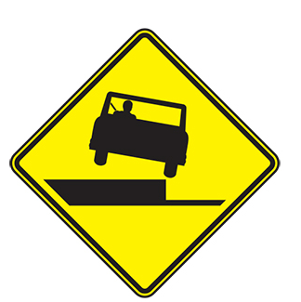
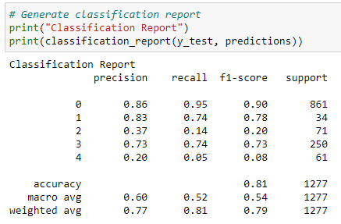
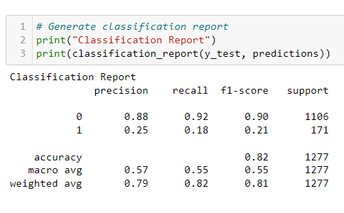
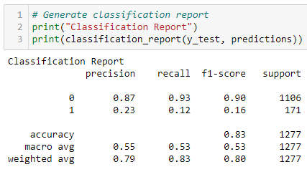
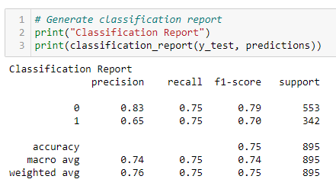
Machine Learning Steps Taken
Step
Step
Step
Step
Step
Run models with all data with injury type target
Target Accident Class
Refine Change encoding
Refine Remove Features
Success Use Over & Under-sampling
Results indicate over fitting and unclear results. Need to rethink the target. Pivot to use Accident Class.
Continued with label encoding. High F1, precision & recall on Non-Fatal predictions. Poor Fatal predictions.
Dig-in and make changes to remove any bias in the category encoding switch to one hot encoding from Label encoding
Remove features related to driver and focus on overall accident features
Correct class imbalance by over sampling fatalities and under sampling non-fatal accidents
Notes:
https://www.entrepreneur.com/article/253169

Slide 3
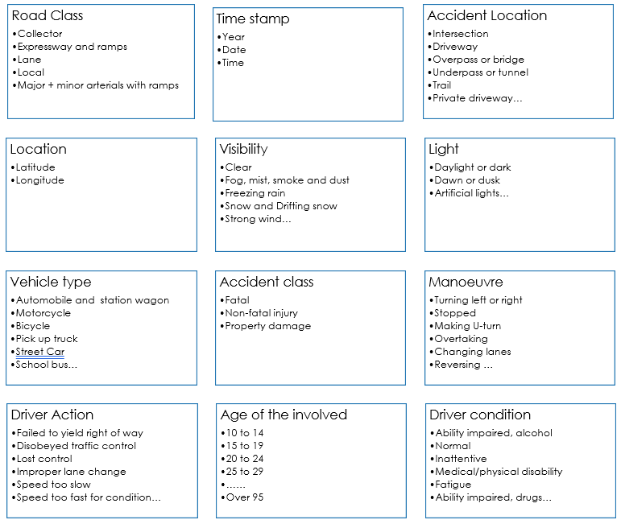
Machine Learning Steps Taken
The first stage involved keeping the majority of features with a few exceptions where the data could not be defined.
The data definitions for each raw file are found in the dataset folder
The models were pre-selected and include:
Random Forest
Gradient Boosted Tree
A size for the split into training and testing sets was not specified and therefore defaults to 25% with scikit-learn. Using Train_size or test_size the split can be specified.
The net result of this first run produced the following result
Step
Notes:
https://www.entrepreneur.com/article/253169

Slide 4
Machine Learning Steps Taken
This initial ML model run in step 1 was muddled. The some of the features were specific to the person involved in the accident and some of the features applied to the overall accident.
A decision was made to only run the model based on the overall accident and not individual participant and actions.
It also meant that the target changed from Injury type (specific to the person) to Accident Class (specific to the accident)
Classification report shows High F1, precision & recall on Non-Fatal predictions however the model performs poorly on Fatal predictions.
Step
Notes:
https://www.entrepreneur.com/article/253169

Slide 5
Machine Learning Steps Taken
+
Step
Step
Refinement
These steps involved making additional decisions:
Paring down the features to remove person specific data
Changes to the encoding from Label Encoder to One Hot Encoder because some categorical columns had a high number of categories. This change ensures there is no ranking of the values because everything is a 1 or a 0 instead of a numerical range
Classification report shows no real improvement over step 2. There is still a high F1, precision & recall score on Non-Fatal predictions however the model performs poorly on Fatal predictions.
Notes:
https://www.entrepreneur.com/article/253169

Slide 6

Machine Learning Steps Taken
Class imbalance was having a big impact on the ML model performance where it was being skewed by the high number of non-fatal records
To correct for this over sampling and under sampling was employed through trial and error and included:
Randomly extracting 50 records of each target and running the ML
Under-sampling the non-fatal records
Over-sampling the fatal accidents
The best result was doubling the fatal records and cutting in half the non-fatal records.
Success at last…
The F1 scores on both fatal and non-fatal predictions is high
Precision and recall are equally good
Step
Notes:
https://www.entrepreneur.com/article/253169

